Slide 1
Jermyn Borough Council Meeting 12/3/20
This Photo by Unknown Author is licensed under CC BY-NC

Slide 2
Meeting Agenda
Call to Order
Pledge of Allegiance
Roll Call
Previous Meeting Minutes
Vacant Council Seat Interviews
Treasurer’s Report, Bills Payable
Correspondence
Public Comment
Special Presentation
Ordinance Advertisement
2021 Budget Passage
Resolution #20-2020 – Setting Tax Millage Rates for 2021
2021 Meeting Dates
New Business
Adjournment

Slide 3
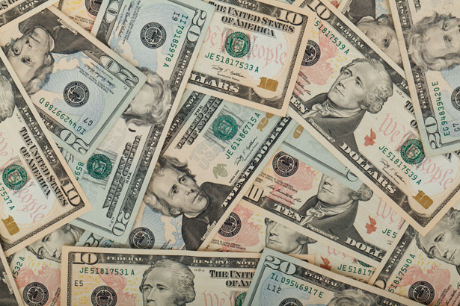
Treasurer’s report
November 19, 2020
ASSETS
Capital Reserve - DPW 13,427.45
Capital Reserve - Police 2,606.44
Crime Watch Fund 755.44
General Fund - Community 194,322.96
General Fund - FNB 1,975.68
Holiday Lights Fund 543.90

Slide 4
Treasurer’s report
Investment - General Fund 1.39
Investment - Liquid Fuels 33,806.66
Investment - Paving Fund 11.91
Investment - Recycling 5,002.59
Investment - Refuse 2,604.51
Liquid Fuels - FNB 31,562.59
Petty Cash 176.42
Recreations Fund 9,338.02
Recycling - Community 9,109.37
Refuse Checking - FNB 36,451.00
Total Checking/Savings 341,696.33

Slide 5
TREASURER’S REPORT
Accounts Payable 10,874.55

